Slide 1
TCGA Data Exploration
Obtaining Meaningful Information from Publicly Available Cancer Data

Slide 2

What is TCGA?
TCGA: The Cancer Genome Atlas
Project started in 2005 using NGS techniques to catalog mutations related to cancer
Cancer types selected based on poor prognosis and public health impact
33 cancer types have been studied, and all have publicly available data.
TCGA Research Network: http://cancergenome.nih.gov/

Slide 3
TCGA-What’s in it?
Annotated Somatic Mutation
Raw Simple Somatic Mutation
Aligned Reads
Gene Expression Quantification
Slide Image
Biospecimen Supplement
Copy Number Segment
Masked Copy Number Segment
Clinical Supplement
Methylation Beta Value
Isoform Expression Quantification
miRNA Expression Quantification
Raw CGI Variant
Aggregated Somatic Mutation
Masked Somatic Mutation

Slide 4
TCGA-Access Tiers
Open Access Data Tier
De-identified clinical and demographic data
Gene expression data
Copy number alterations in regions of the genome
Epigenetic data
Other data…
Controlled Access Data Tier
The Controlled Access data tier contains data that may be unique to an individual.
Access requires completion of Data Access Request through dbGaP website.
Other restrictions apply
Database of Genotypes and Phenotypes : https://dbgap.ncbi.nlm.nih.gov/

Slide 5
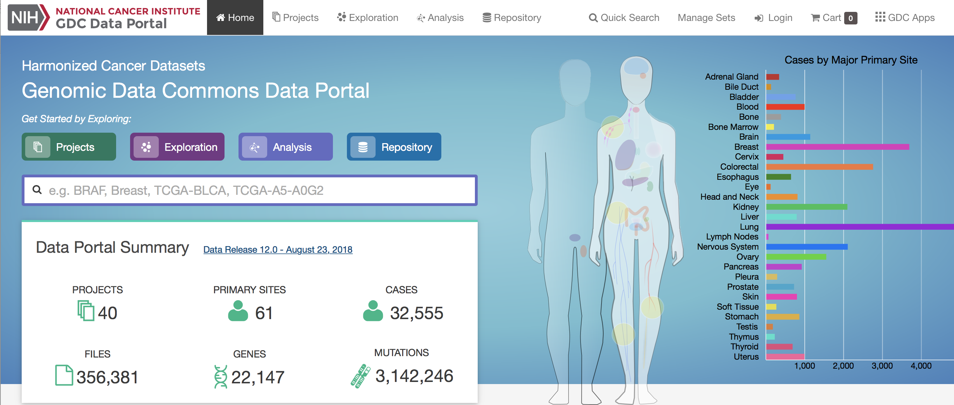
The GDC
Genomic Data Commons
Website to explore projects
Notes:
Show data
Project tab, shows just that and stats
Explore tab, show sample , files top right, will take to repository tab
Choose transcriptome profiling
Choose fpkm, fragments per kilobase of transcript per million reads
Save two projects and click analysis, can compare cohorts and get some other data.
Limited usefulness.

Slide 6
GDC Website
Limited in its usefulness
Pros:
Great for checking whether there is data of your cancer of interest.
Relatively easy to navigate.
Cons
Not great for analysis and visualization.
Downloading large batches of data not easy or intuitive.

Slide 7

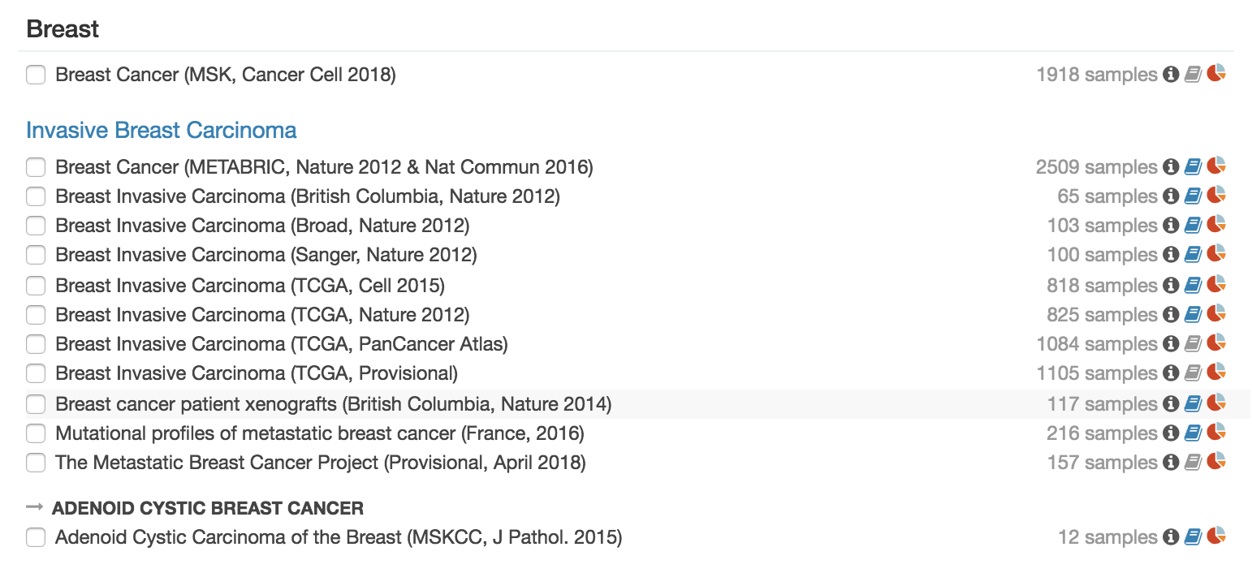
Website hosted by Center for Molecular Ontology
Designed to facilitate exploration of multidimensional cancer genomics data sets.
Available data includes TCGA and many other datasets:
cBioPortal http://www.cbioportal.org/
Available data: http://www.cbioportal.org/data_sets.jsp
Notes:
Choose some genes and a couple studies,

Slide 8
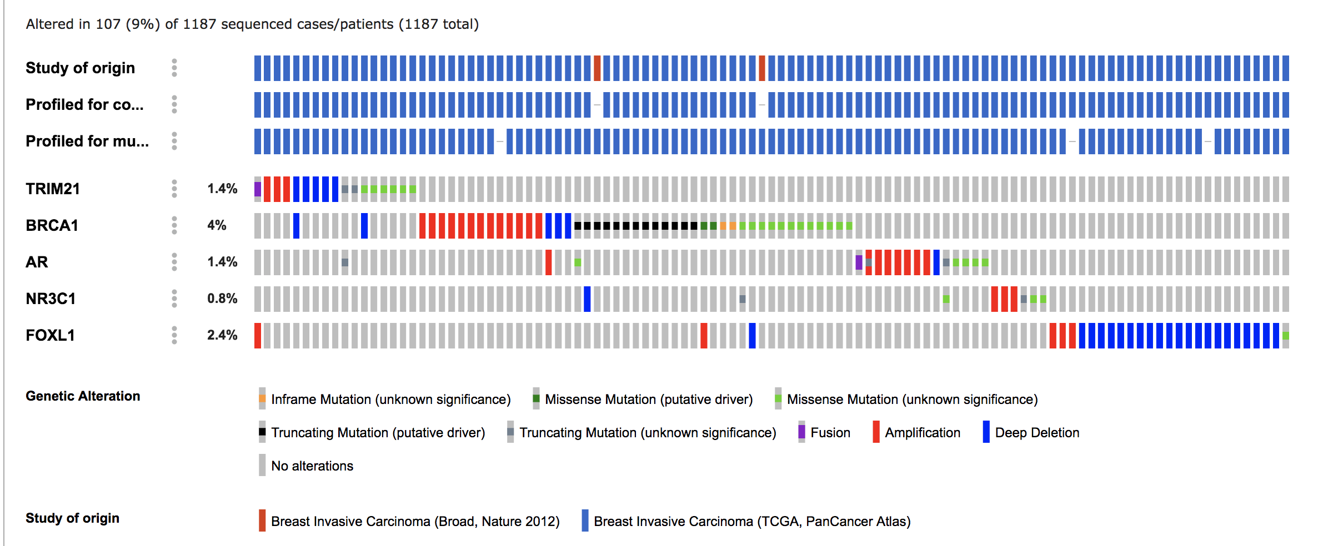
cBioPortal http://www.cbioportal.org/
Available data: http://www.cbioportal.org/data_sets.jsp
Notes:
Oncoprint output:
Each column is a sample/patient
Rows are genes
Percentage is percent of samples with alteration
Gene mutation mutually exclusive, mutation and age

Slide 9
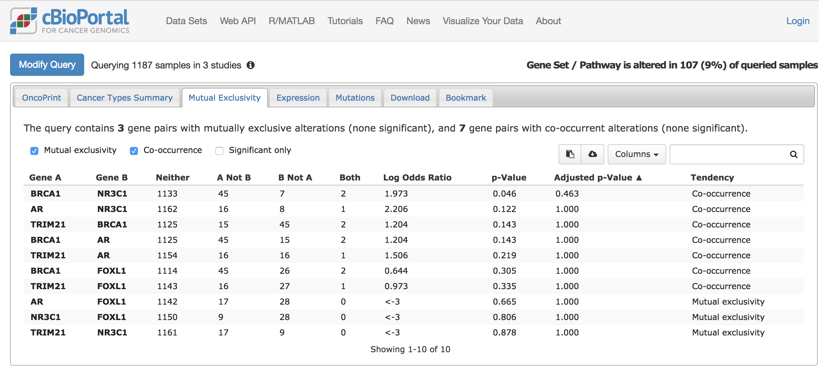
cBioPortal http://www.cbioportal.org/
Available data: http://www.cbioportal.org/data_sets.jsp
Notes:
Mutual exclusivity
Long odds ratio; negative means mutually exclusive, positive means co-occur
In our example none are significant(adjusted p-value)

Slide 10
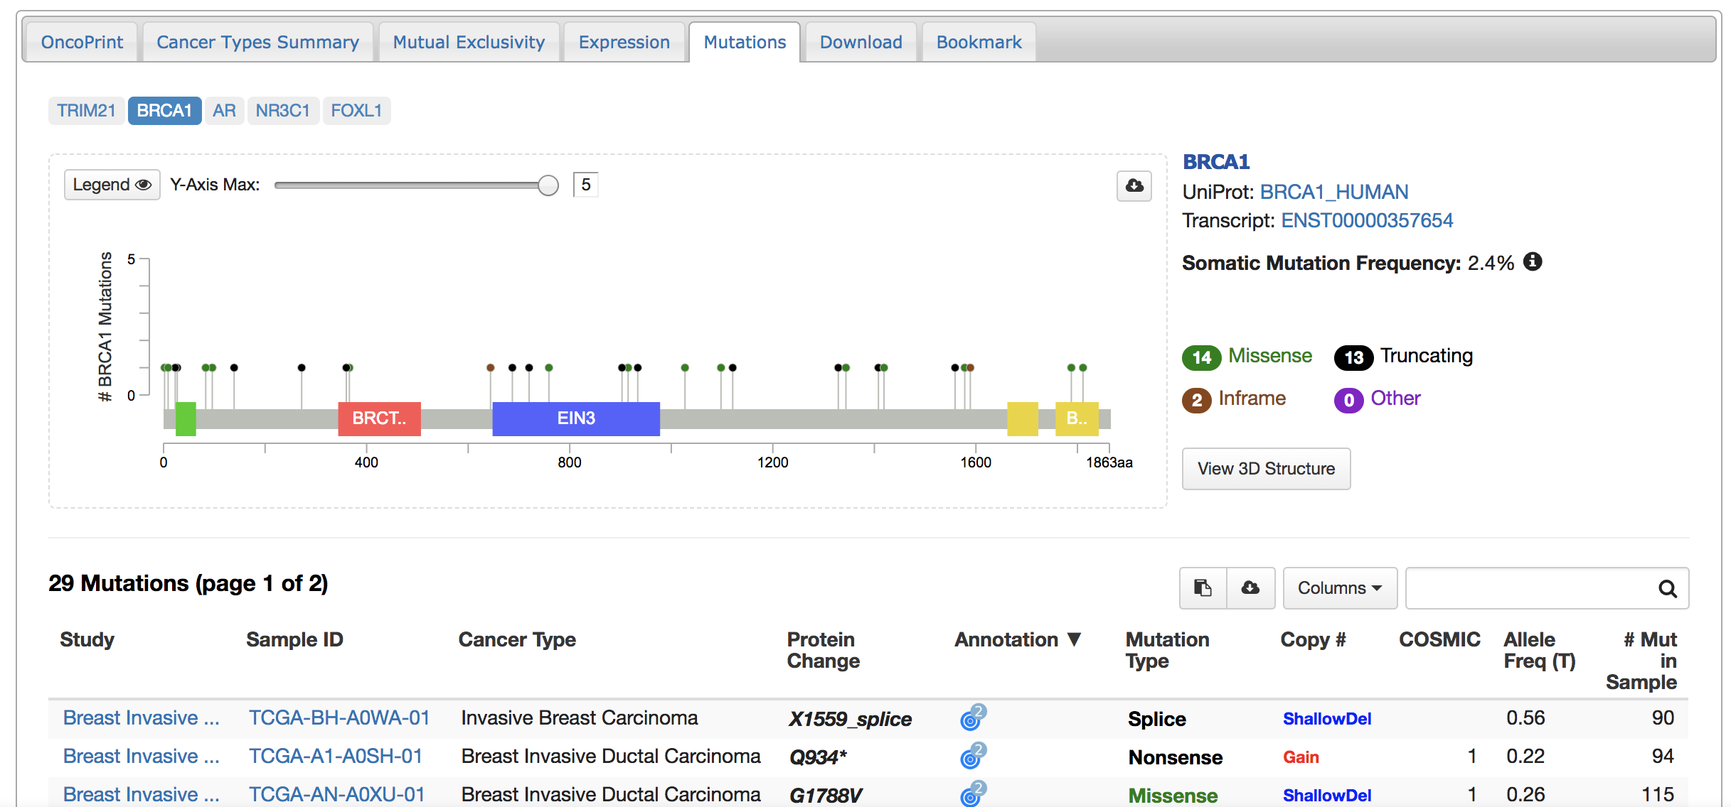
cBioPortal http://www.cbioportal.org/
Available data: http://www.cbioportal.org/data_sets.jsp
Notes:
Mutations
Shows mutations detected in samples. Represented by lollipops. Taller means more occurrences.

Slide 11
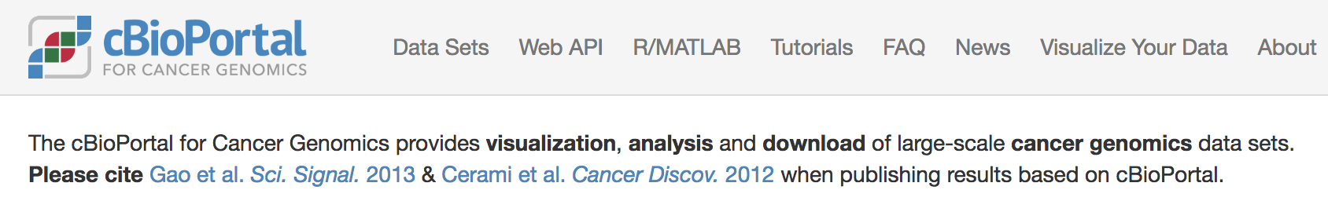
Lots of other data found on the website!
Check out their tutorials:
Great for understanding how to get the most out of the website.
http://www.cbioportal.org/tutorial.jsp
Please cite cBioPortal if you use figures or data from the website in your publication.
cBioPortal http://www.cbioportal.org/
Available data: http://www.cbioportal.org/data_sets.jsp
Notes:
Mutual exclusivity
Long odds ratio; negative means mutually exclusive, positive means co-occur
In our example none are significant(adjusted p-value)

Slide 12
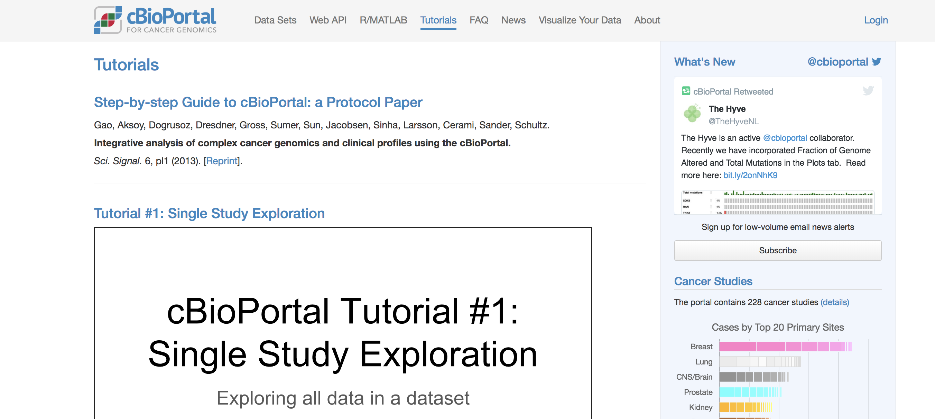
Click here!
cBioPortal http://www.cbioportal.org/
Available data: http://www.cbioportal.org/data_sets.jsp

Slide 13
TCGAbiolinks
R packaged designed to facilitate the following:
GDC open-access data retrieval
Preparation of data
Provide means to analyze the data
Available from Bioconductor
TCGAbiolinks: https://bioconductor.org/packages/release/bioc/html/TCGAbiolinks.html
Colaprico, et al. (2015). “ TCGAbiolinks: An R/Bioconductor package for integrative analysis of TCGA data.” Nucleic Acids Research. doi: 10.1093/nar/gkv1507, http://doi.org/10.1093/nar/gkv1507.

Slide 14
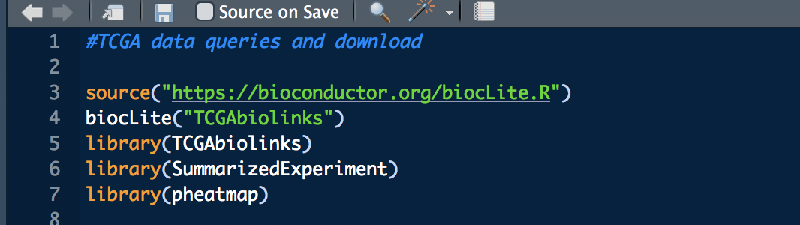
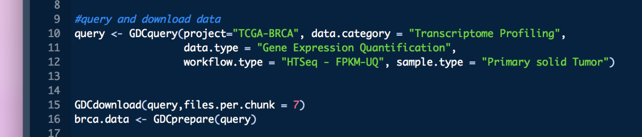
Required packages:
Create the query:

Slide 15
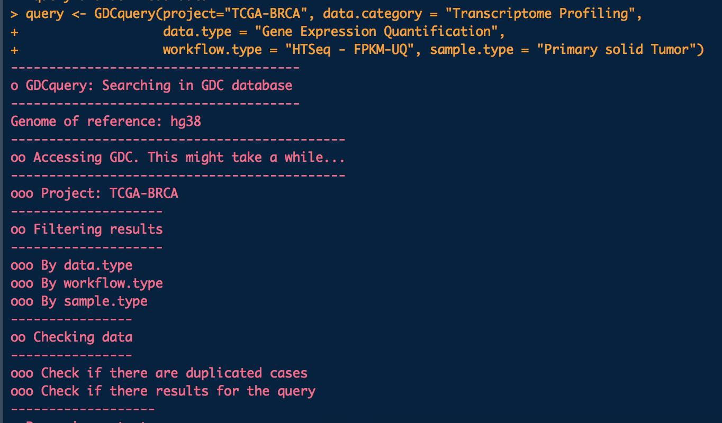

Slide 16
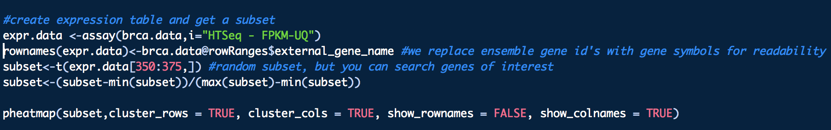

Slide 17
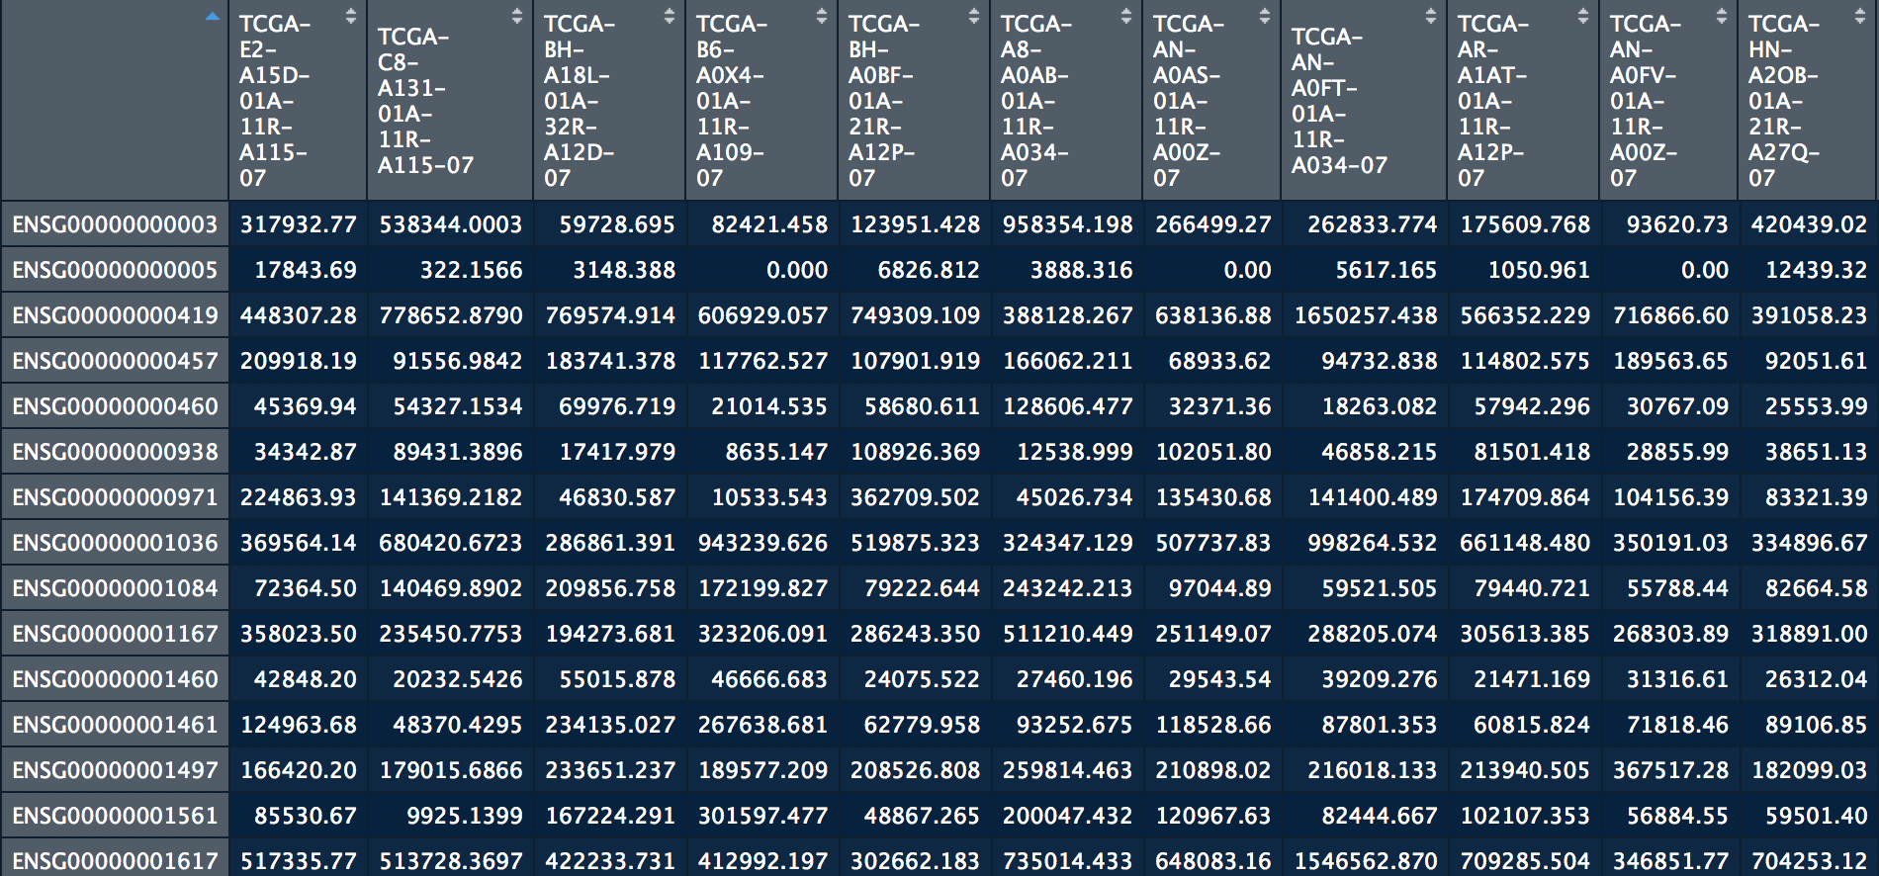

Slide 18
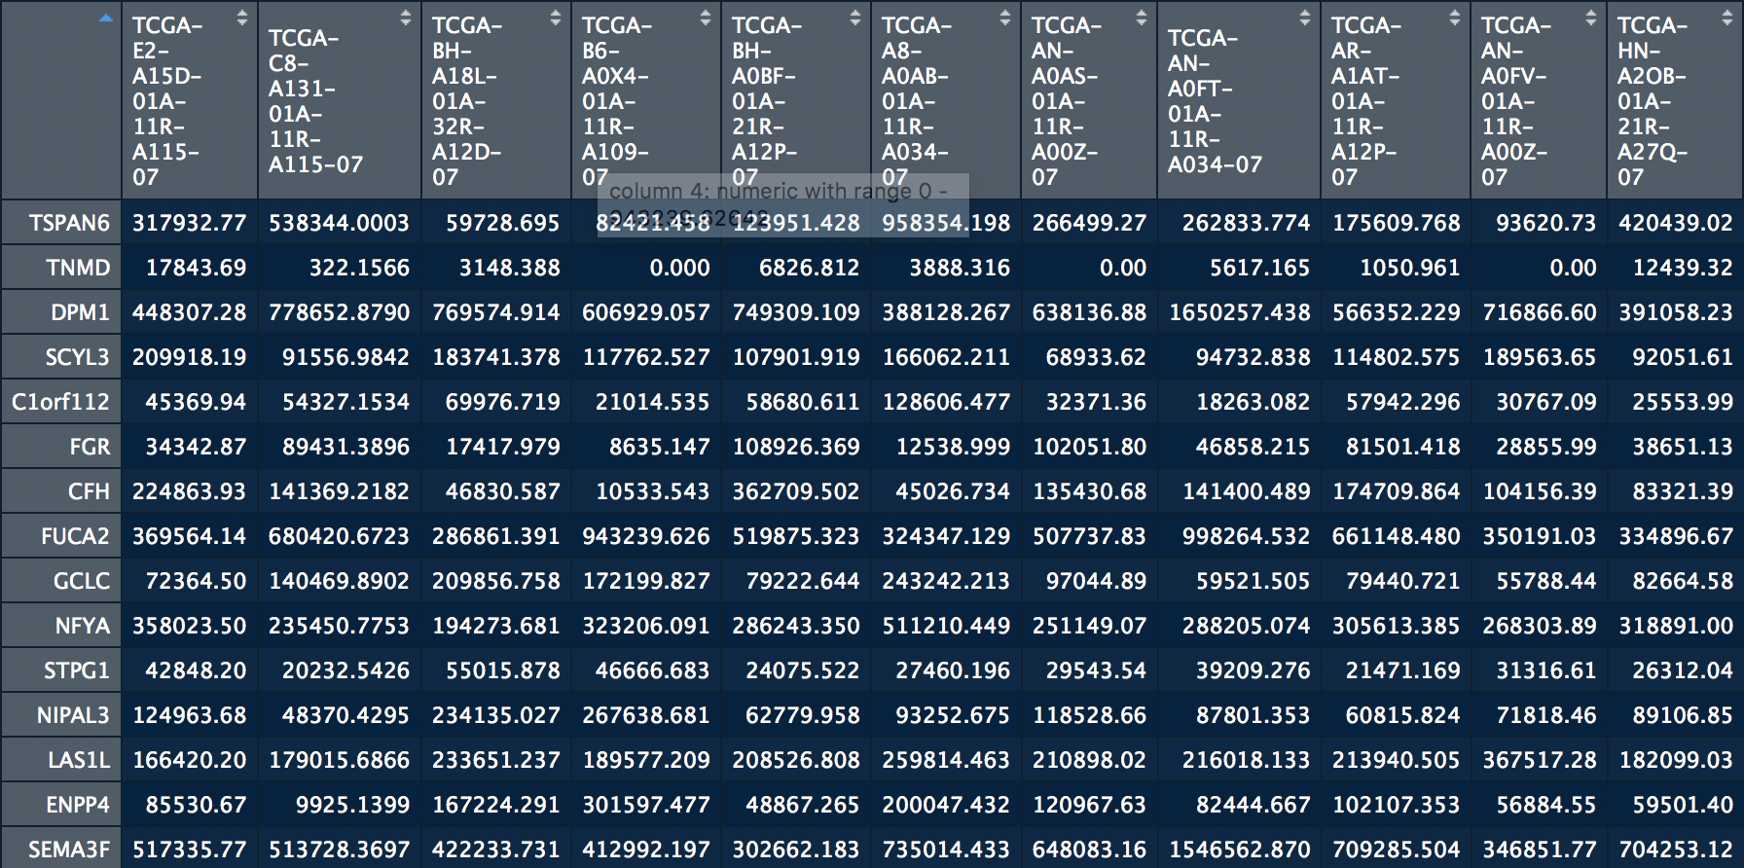

Slide 19
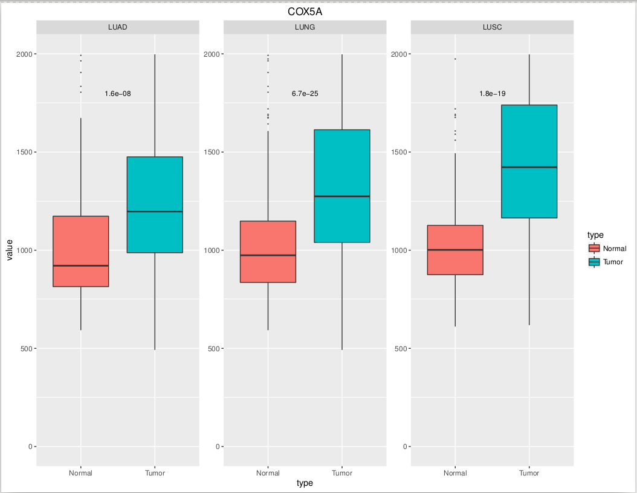
Bioinformatics Core Facility
Most common requests:
Survival plots and gene expression boxplots
Notes:
App available on Astrocyte

Slide 22
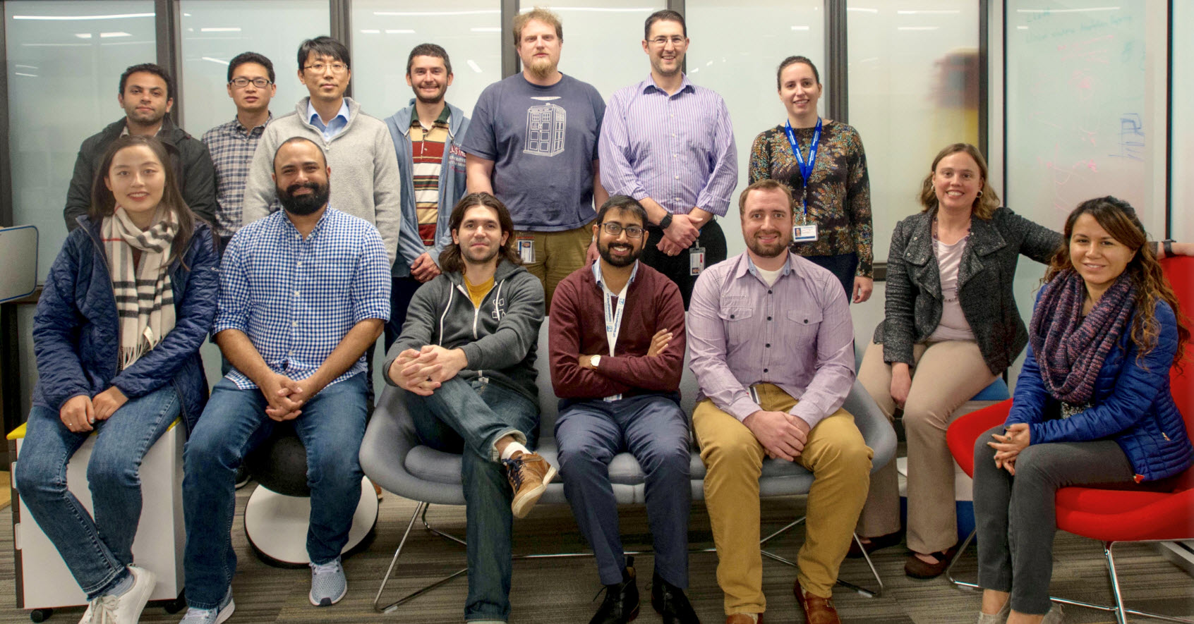
BICF Help Desk
Email: bicf@utsouthwestern.edu
Hours: 9 AM - 11 AM, Monday and Friday
1 PM - 3 PM, Wednesday
Location: E4.350

